Slide 1
Course Contains – Day 1
Basic features and advantages of PL/SQL
Data types, variables
Constant, literals, conditions
Loops
Strings
Arrays
Cursors
Procedures/ Functions

Slide 2
PL/SQL
SQL is a structured query language whereas PL-SQL is a combination of procedural language & SQL. SQL is a data oriented language for selecting & manipulating sets of data and pl/sql is a procedural language to create application. While PL/SQL is used to code program blocks, triggers, procedures, functions and packages.

Slide 3
Why PL/SQL
PL/SQL program units can return a set of values (functions), or PL/SQL routines can perform database operations (procedures). These functions and procedures may be called by other functions and procedures or (in the case of functions) used in SQL statements

Slide 4
Objects of Database
Table
Views
Procedure
Index
Triggers
Constraints

Slide 5
Table
The table is the primary storage object for data in a relational database. In its simplest form, a table consists of row(s) and column(s), both of which hold the data. A table takes up physical space in a database and can be permanent or temporary.

Slide 6
Temp Table
Global temp tables are available to all SQL Server sessions or connections (means all the user). These can be created by any SQL Server connection user and these are automatically deleted when all the SQL Server connections have been closed. Global temporary table name is stared with double hash ("##") sign

Slide 7
Temp Table
Local temp tables are available to the current procedure or function. Local temporary table name is stared with single hash ("#") sign

Slide 8
Constraints
Check (CHK) constraints can be utilized to check the validity of data entered into particular table columns. Check constraints are used to provide back-end database edits, although edits are commonly found in the front-end application as well. General edits restrict values that can be entered into columns or objects, whether within the database itself or on a front-end application. The check constraint is a way of providing another protective layer for the data.
Primary Key , Unique , NULL , Foreign Key are few example

Slide 9
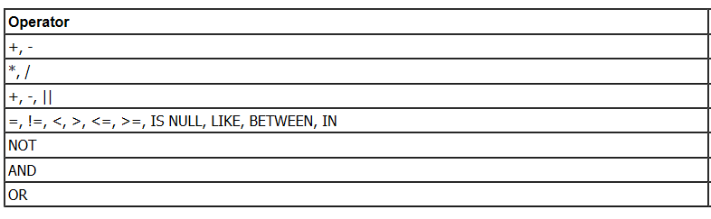
Operators

Slide 10
Views
A database view is a searchable object in a database that is defined by a query. Though a view doesn't store data, some refer to a views as “virtual tables,” you can query a view like you can a table. A view can combine data from two or more table, using joins, and also just contain a subset of information

Slide 11
Procedure
The SQL CREATE PROCEDURE statement is used to create stored procedures that are stored in the database. It is set of instruction needs to be executed. Procedure is not going to return the value

Slide 12
Index
An index is used to speed up the performance of queries. It does this by reducing the number of database data pages that have to be visited/scanned. In SQL Server, a clustered index determines the physical order of data in a table. There can be only one clustered index per table.
We can also create Non Clustered index which can be multiple

Slide 13
Q & A
Is this Good to have Index every time
How many Clustered index can be created
What is difference between Primary Key and Unique Constraints
A column add with Not Null constraint , Will it be allowed
Is Primary Key good for tables

Slide 14
Trigger
A trigger is a special kind of stored procedure that automatically executes when an event occurs in the database server. DML triggers execute when a user tries to modify data through a data manipulation language (DML) event. DML events are INSERT, UPDATE, or DELETE statements on a table or view

Slide 15
Data Type
Each column in a database table is required to have a name and a data type.
An SQL developer must decide what type of data that will be stored inside each column when creating a table. The data type is a guideline for SQL to understand what type of data is expected inside of each column, and it also identifies how SQL will interact with the stored data.

Slide 16
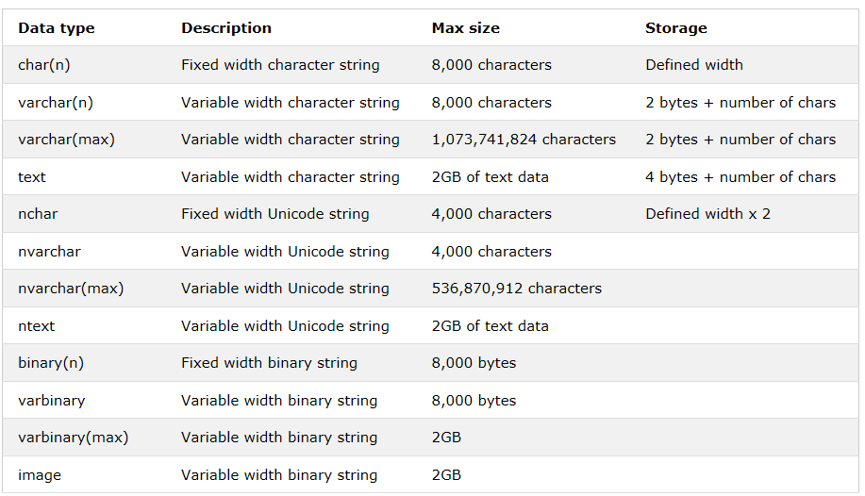
Different Data Types

Slide 17
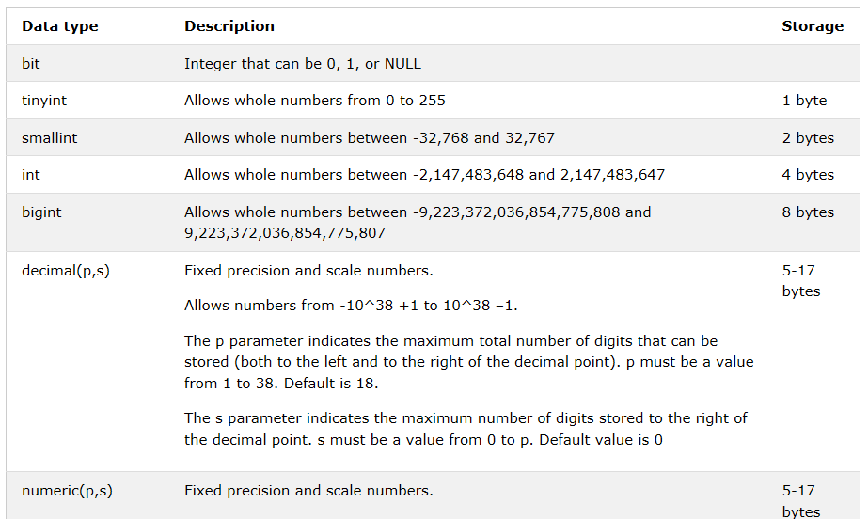
Different Data Types

Slide 18
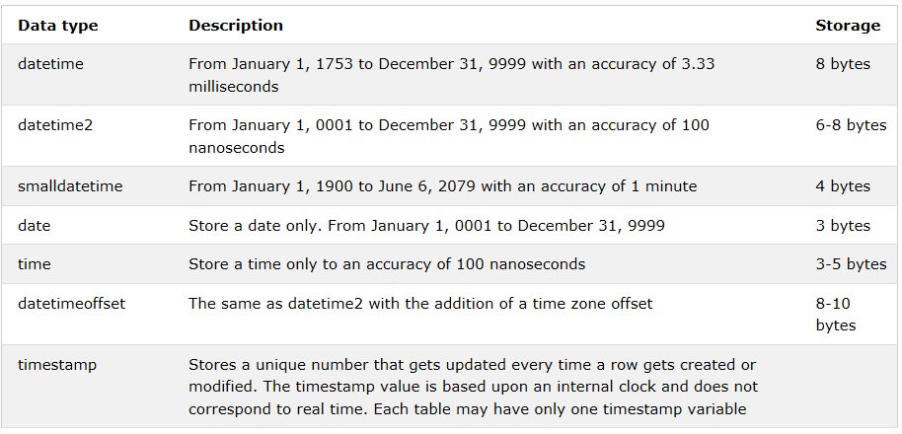
Different Data Types

Slide 19
Use of Data type
When you are sure of Size , use Char
In case of Char performance is high
Integer search will be always faster
Avoid nchar and nvarchar if possible since both the data types takes just double memory as char and varchar
Better to create indexes on columns that have integer values instead of characters. Integer values use less overhead than character values

Slide 20
Variable
Transact-SQL Variables. A Transact-SQL local variable is an object that can hold a single data value of a specific type. Variables in batches and scripts are typically used: As a counter either to count the number of times a loop is performed or to control how many times the loop is performed.

Slide 21
Variable Declaration
Variables in SQL procedures are defined by using the DECLARE statement.
Values can be assigned to variables using the SET statement or the SELECT INTO statement or as a default value when the variable is declared. Literals, expressions, the result of a query, and special register values can be assigned to variables.

Slide 22
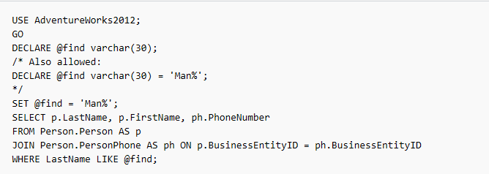
Variable Declaration

Slide 23
Global Variable
All the global variables represent information specific to the server or a current user session. Global variable names begin with a @@ prefix. You do not need to declare them, since the server constantly maintains them. They are system-defined functions and you cannot declare them

Slide 24
Global Variable Example
@@CONNECTIONS
@@MAX_CONNECTIONS
@@CPU_BUSY
@@ERROR
@@IDENTITY
@@IDLE
@@IO_BUSY
@@LANGID
@@LANGUAGE
@@MAXCHARLEN
@@PACK_RECEIVED
@@PACK_SENT
@@PACKET_ERRORS
@@ROWCOUNT
@@SERVERNAME
@@SPID
@@TEXTSIZE
@@TIMETICKS
@@TOTAL_ERRORS
@@TOTAL_READ / @@TOTAL_WRITE
@@TRANCOUNT
@@VERSION

Slide 25
Constant
PL/SQL Constants. As the name implies a constant is a value used in a PL/SQL Block that remains unchanged throughout the program. A constant is a user-defined literal value. You can declare a constant and use it instead of actual value.

Slide 26
Constant Definition
constant_name CONSTANT datatype := VALUE;
•constant_name is the name of the constant i.e. similar to a variable name.
•The word CONSTANT is a reserved word and ensures that the value does not change.
•VALUE - It is a value which must be assigned to a constant when it is declared. You cannot assign a value later.

Slide 27
Literals
The PL/SQL Literals. A literal is an explicit numeric, character, string, or Boolean value not represented by an identifier. For example, TRUE, 786, NULL, 'tutorialspoint' are all literals of type Boolean, number, or string

Slide 28
Literals Example
DECLARE @earliest date = '20140701';
select * from ORADB..SCHEMA.MYTABLE where MYDATE >= @earliest;
SELECT 'doctor''s office‘
Results: --------------- doctor's office (1 row(s) affected)
Or you can use the SET QUOTED_IDENTIFIER = OFF option and enclose the entire string in double quotes:
SET QUOTED_IDENTIFIER OFF
SELECT "O'Brian“
Results: ------- O'Brian

Slide 29
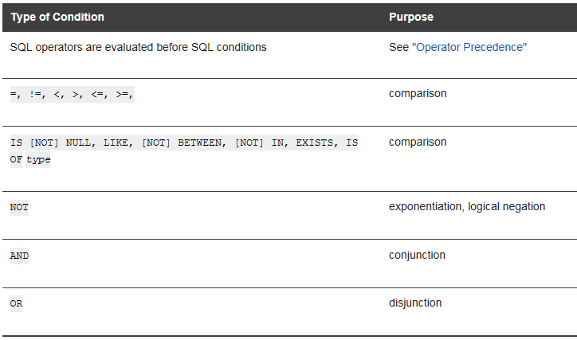
Conditions

Slide 30
Condition
You can use a condition in any of these clauses of the SELECT statement:
WHERE
Like
HAVING

Slide 31
Loop
Repeats a statement or group of statements while a given condition is true. It tests the condition before executing the loop body. Execute a sequence of statements multiple times and abbreviates the code that manages the loop variable. You can use one or more loop inside any another basic loop, while, or for loop.

Slide 32
Loop
DECLARE @i int = 0
WHILE @i < 20
BEGIN
SET @i = @i + 1 /* do some work */
END

Slide 33
Use Break in Loop
DECLARE @site_value INT;
SET @site_value = 0;
WHILE @site_value <= 10
BEGIN
IF @site_value = 2
BREAK;
ELSE
BEGIN
SET @site_value = @site_value + 1;
PRINT 'Inside WHILE LOOP Training';
CONTINUE;
END;
END;

Slide 34
Strings
string is any finite sequence of characters (i.e., letters, numerals, symbols and punctuation marks). An important characteristic of each string is its length, which is the number of characters in it. The length can be any natural number

Slide 35
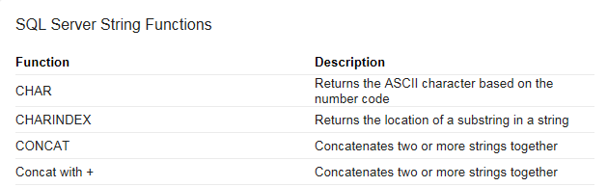
Few String Functions

Slide 36
Arrays
Arrays can be ordinary arrays and associative arrays . Ordinary arrays have a user-defined upper bound. Elements in the array can be accessed and modified by their index value. Array elements are referenced in SQL statements by using one-based indexing; for example, MYARRAY[1], MYARRAY[2], and so on.

Slide 37
Cursor
cursor is a control structure that enables traversal over the records in a database. Cursors facilitate subsequent processing in conjunction with the traversal, such as retrieval, addition and removal of database records. ... A cursor can be viewed as a pointer to one row in a set of rows

Slide 38
What is cursor used for in SQL?
A cursor is a temporary work area created in the system memory when a SQL statement is executed. A cursor contains information on a select statement and the rows of data accessed by it. This temporary work area is used to store the data retrieved from the database, and manipulate this data

Slide 39
Cursor Example
DECLARE Employee_Cursor CURSOR FOR
SELECT EmployeeID, Title FROM AdventureWorks2012.HumanResources.Employee;
OPEN Employee_Cursor;
FETCH NEXT FROM Employee_Cursor;
WHILE @@FETCH_STATUS = 0
BEGIN
FETCH NEXT FROM Employee_Cursor;
END;
CLOSE Employee_Cursor;
DEALLOCATE Employee_Cursor;
GO

Slide 40
Update in Cursor
DECLARE @var3 FLOAT
DECLARE cursor3 CURSOR FOR
SELECT col2, col3 FROM table1 FOR UPDATE OF col3
OPEN cursor3
FETCH FIRST FROM cursor3
WHILE (@@FETCH_STATUS > -1)
BEGIN
UPDATE @table1 SET col3 = isnull(@var3, 0) + isnull(col2, 0)
WHERE CURRENT OF cursor3
FETCH NEXT FROM cursor3 INTO @var3
END

Slide 41
Procedure
The SQL CREATE PROCEDURE statement is used to create stored procedures that are stored in the database. It is set of instruction needs to be executed. Procedure is not going to return the value

Slide 42
What is a function in SQL Server?
Creates a user-defined function in SQL Server and Azure SQL Database. A user-defined function is a Transact-SQL or common language runtime (CLR) routine that accepts parameters, performs an action, such as a complex calculation, and returns the result of that action as a value

Slide 43
Some common Function
Aggregate Functions
Sum
Avg
Count
Max
Min

Slide 44
Some common functions
Trim,Ltrim,Rtrim
Substr,mid
Chr
Val
isnull
Replace
Lower/upper
Round

Slide 45
Conditional Function
IIF Function
Argument | Description
expr | Required. Expression you want to evaluate.
truepart | Required. Value or expression returned if expr is True.
falsepart | Required. Value or expression returned if expr is False.

Slide 46
Q & A
What is difference between Procedure and Function
Does Aggregate function always requires Group by clause

Slide 47
Day 2
Procedure Writing
Optimization of SQL Query
Triggers
Records
Exceptions
Packages
Collections
Transactions
PL/SQL functions like NVL, DECODE, NANVL, NVL2 etc.

